Slide 1
UNIT-1

Slide 2
Codd's 12 Rules
Dr Edgar F. Codd, after his extensive research on the Relational Model of database systems, came up with twelve rules of his own, which according to him, a database must obey in order to be regarded as a true relational database.
These rules can be applied on any database system that manages stored data using only its relational capabilities. This is a foundation rule, which acts as a base for all the other rules.

Slide 3
Rule 1: Information Rule
The data stored in a database, may it be user data or metadata, must be a value of some table cell. Everything in a database must be stored in a table format.
Rule 2: Guaranteed Access Rule
Every single data element (value) is guaranteed to be accessible logically with a combination of table-name, primary-key (row value), and attribute-name (column value). No other means, such as pointers, can be used to access data.

Slide 4
Rule 3: Systematic Treatment of NULL Values
The NULL values in a database must be given a systematic and uniform treatment. This is a very important rule because a NULL can be interpreted as one the following − data is missing, data is not known, or data is not applicable.
Rule 4: Active Online Catalog
The structure description of the entire database must be stored in an online catalog, known as data dictionary, which can be accessed by authorized users. Users can use the same query language to access the catalog which they use to access the database itself.

Slide 5
Rule 5: Comprehensive Data Sub-Language Rule
A database can only be accessed using a language having linear syntax that supports data definition, data manipulation, and transaction management operations. This language can be used directly or by means of some application. If the database allows access to data without any help of this language, then it is considered as a violation.
Rule 6: View Updating Rule
All the views of a database, which can theoretically be updated, must also be updatable by the system.

Slide 6
Rule 7: High-Level Insert, Update, and Delete Rule
A database must support high-level insertion, updation, and deletion. This must not be limited to a single row, that is, it must also support union, intersection and minus operations to yield sets of data records.
Rule 8: Physical Data Independence
The data stored in a database must be independent of the applications that access the database. Any change in the physical structure of a database must not have any impact on how the data is being accessed by external applications.
Rule 9: Logical Data Independence
The logical data in a database must be independent of its user’s view (application). Any change in logical data must not affect the applications using it. For example, if two tables are merged or one is split into two different tables, there should be no impact or change on the user application. This is one of the most difficult rule to apply.

Slide 7
Rule 10: Integrity Independence
A database must be independent of the application that uses it. All its integrity constraints can be independently modified without the need of any change in the application. This rule makes a database independent of the front-end application and its interface.
Rule 11: Distribution Independence
The end-user must not be able to see that the data is distributed over various locations. Users should always get the impression that the data is located at one site only. This rule has been regarded as the foundation of distributed database systems.
Rule 12: Non-Subversion Rule
If a system has an interface that provides access to low-level records, then the interface must not be able to subvert the system and bypass security and integrity constraints.

Slide 8
DBMS Architecture
The DBMS design depends upon its architecture. The basic client/server architecture is used to deal with a large number of PCs, web servers, database servers and other components that are connected with networks.
The client/server architecture consists of many PCs and a workstation which are connected via the network.
DBMS architecture depends upon how users are connected to the database to get their request done.

Slide 9
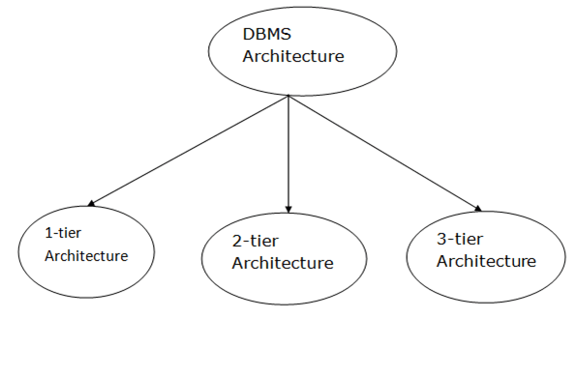
Types of DBMS Architecture

Slide 10
Database architecture can be seen as a single tier or multi-tier. But logically, database architecture is of two types like: 2-tier architecture and 3-tier architecture.
1-Tier Architecture
In this architecture, the database is directly available to the user. It means the user can directly sit on the DBMS and uses it.
Any changes done here will directly be done on the database itself. It doesn't provide a handy tool for end users.
The 1-Tier architecture is used for development of the local application, where programmers can directly communicate with the database for the quick response.

Slide 11
2-Tier Architecture
The 2-Tier architecture is same as basic client-server. In the two-tier architecture, applications on the client end can directly communicate with the database at the server side. For this interaction, API's like: ODBC, JDBC are used.
The user interfaces and application programs are run on the client-side.
The server side is responsible to provide the functionalities like: query processing and transaction management.
To communicate with the DBMS, client-side application establishes a connection with the server side.

Slide 12
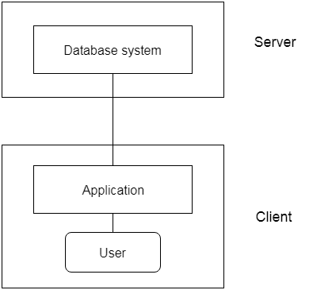
2-tier Architecture

Slide 13
3-Tier Architecture
3-Tier Architecture
The 3-Tier architecture contains another layer between the client and server. In this architecture, client can't directly communicate with the server.
The application on the client-end interacts with an application server which further communicates with the database system.
End user has no idea about the existence of the database beyond the application server. The database also has no idea about any other user beyond the application.
The 3-Tier architecture is used in case of large web application.

Slide 14
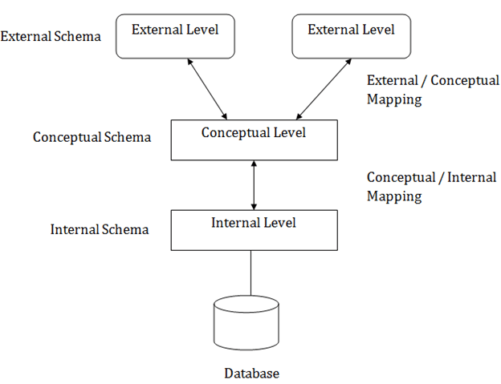
Three schema Architecture

Slide 15
The three schema architecture is also called ANSI/SPARC architecture or three-level architecture.
This framework is used to describe the structure of a specific database system.
The three schema architecture is also used to separate the user applications and physical database.
The three schema architecture contains three-levels. It breaks the database down into three different categories.

Slide 16
The main objective of three level architecture is to enable multiple users to access the same data with a personalized view while storing the underlying data only once. Thus it separates the user's view from the physical structure of the database. This separation is desirable for the following reasons:
Different users need different views of the same data.
The approach in which a particular user needs to see the data may change over time.
The users of the database should not worry about the physical implementation and internal workings of the database such as data compression and encryption techniques, hashing, optimization of the internal structures etc.
All users should be able to access the same data according to their requirements.
DBA should be able to change the conceptual structure of the database without affecting the user's
Internal structure of the database should be unaffected by changes to physical aspects of the storage.

Slide 17
Internal Level
The internal level has an internal schema which describes the physical storage structure of the database.
The internal schema is also known as a physical schema.
It uses the physical data model. It is used to define that how the data will be stored in a block.
The physical level is used to describe complex low-level data structures in detail.

Slide 18
For Example: storage:B-Trees, Hashing etc.
Access paths. For Example: Specification of primary and secondary keys, indexes, pointers and sequencing.
Data compression and encryption techniques.
Optimization of internal structures.
Representation of stored fields.

Slide 19
Conceptual level
The conceptual schema describes the design of a database at the conceptual level. Conceptual level is also known as logical level.
The conceptual schema describes the structure of the whole database.
The conceptual level describes what data are to be stored in the database and also describes what relationship exists among those data.
In the conceptual level, internal details such as an implementation of the data structure are hidden.
Programmers and database administrators work at this level.

Slide 20
External Level
At the external level, a database contains several schemas that sometimes called as subschema. The subschema is used to describe the different view of the database.
An external schema is also known as view schema.
Each view schema describes the database part that a particular user group is interested and hides the remaining database from that user group.
The view schema describes the end user interaction with database systems.

Slide 21
DBMS is responsible for correspondence between the three types of schema. This correspondence is called Mapping.
There are basically two types of mapping in the database architecture:
Conceptual/ Internal Mapping
External / Conceptual Mapping
Conceptual/ Internal Mapping
The Conceptual/ Internal Mapping lies between the conceptual level and the internal level. Its role is to define the correspondence between the records and fields of the conceptual level and files and data structures of the internal level.
External/ Conceptual Mapping
The external/Conceptual Mapping lies between the external level and the Conceptual level. Its role is to define the correspondence between a particular external and the conceptual view.

Slide 22
ACID PROPERTIES
DBMS is the management of data that should remain integrated when any changes are done in it. It is because if the integrity of the data is affected, whole data will get disturbed and corrupted. Therefore, to maintain the integrity of the data, there are four properties described in the database management system, which are known as the ACID properties. The ACID properties are meant for the transaction that goes through a different group of tasks, and there we come to see the role of the ACID properties.

Slide 23
1) Atomicity
The term atomicity defines that the data remains atomic. It means if any operation is performed on the data, either it should be performed or executed completely or should not be executed at all. It further means that the operation should not break in between or execute partially. In the case of executing operations on the transaction, the operation should be completely executed and not partially.

Slide 24
2) Consistency
The word consistency means that the value should remain preserved always. In DBMS, the integrity of the data should be maintained, which means if a change in the database is made, it should remain preserved always. In the case of transactions, the integrity of the data is very essential so that the database remains consistent before and after the transaction. The data should always be correct.

Slide 25
3) Isolation
The term 'isolation' means separation. In DBMS, Isolation is the property of a database where no data should affect the other one and may occur concurrently. In short, the operation on one database should begin when the operation on the first database gets complete. It means if two operations are being performed on two different databases, they may not affect the value of one another. In the case of transactions, when two or more transactions occur simultaneously, the consistency should remain maintained. Any changes that occur in any particular transaction will not be seen by other transactions until the change is not committed in the memory.

Slide 26
4) Durability
Durability ensures the permanency of something. In DBMS, the term durability ensures that the data after the successful execution of the operation becomes permanent in the database. The durability of the data should be so perfect that even if the system fails or leads to a crash, the database still survives. However, if gets lost, it becomes the responsibility of the recovery manager for ensuring the durability of the database. For committing the values, the COMMIT command must be used every time we make changes.

Slide 27
Data Independence
Data independence can be explained using the three-schema architecture.
Data independence refers characteristic of being able to modify the schema at one level of the database system without altering the schema at the next higher level.
There are two types of data independence:
1. Logical Data Independence
Logical data independence refers characteristic of being able to change the conceptual schema without having to change the external schema.
Logical data independence is used to separate the external level from the conceptual view.
If we do any changes in the conceptual view of the data, then the user view of the data would not be affected.
Logical data independence occurs at the user interface level.

Slide 28
2. Physical Data Independence
Physical data independence can be defined as the capacity to change the internal schema without having to change the conceptual schema.
If we do any changes in the storage size of the database system server, then the Conceptual structure of the database will not be affected.
Physical data independence is used to separate conceptual levels from the internal levels.
Physical data independence occurs at the logical interface level.

Slide 29
